Slide 1
Chapter 8
Arrays

Slide 2
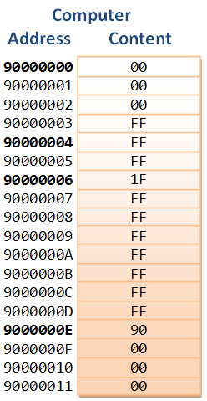
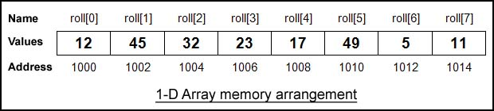
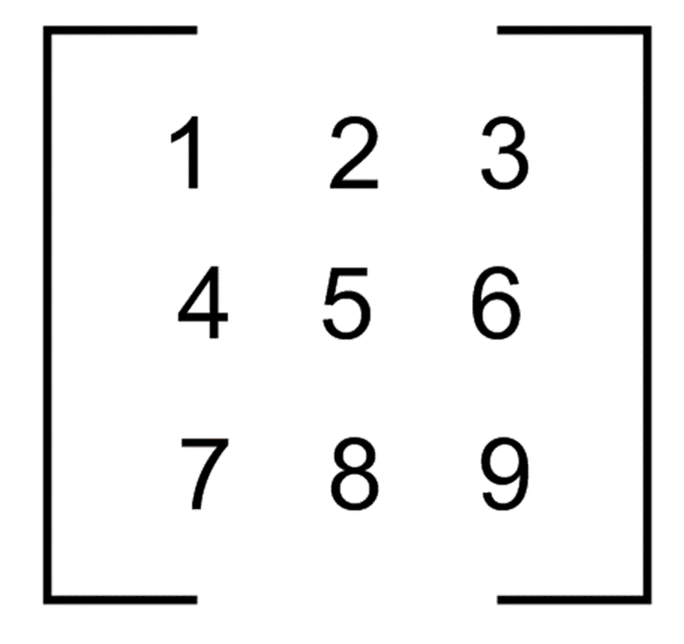
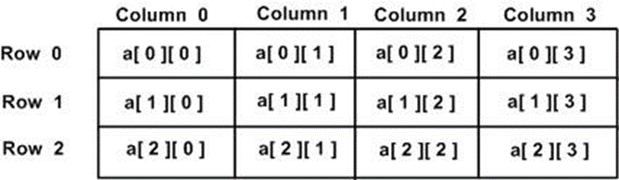
Why we need Array?

Slide 3
Scalar Variables versus Aggregate Variables
So far, the only variables we’ve seen are scalar: capable of holding a single data item.
C also supports aggregate variables, which can store collections of values.
There are two kinds of aggregates in C: arrays and structures.
The focus of the chapter is on one-dimensional arrays, which play a much bigger role in C than do multidimensional arrays.

Slide 4
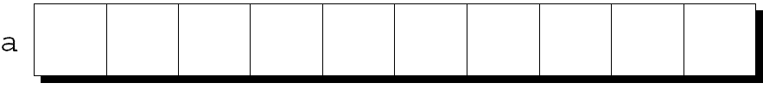
One-Dimensional Arrays
An array is a data structure containing a number of data values, all of which have the same type.
These values, known as elements, can be individually selected by their position within the array.
The simplest kind of array has just one dimension.
The elements of a one-dimensional array a are conceptually arranged one after another in a single row (or column):

Slide 5
One-Dimensional Arrays
To declare an array, we must specify the type of the array’s elements and the number of elements:
int a[10];
The elements may be of any type; the length of the array can be any (integer) constant expression.
Using a macro to define the length of an array is an excellent practice:
#define N 10
…
int myArrayVarName[N];

Slide 6
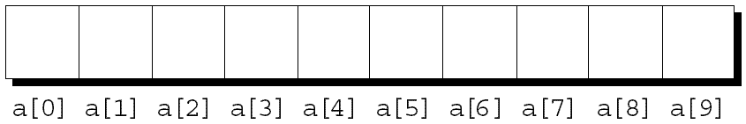

Array Subscripting
To access an array element, write the array name followed by an integer value in square brackets.
This is referred to as subscripting or indexing the array.
The elements of an array of length n are indexed from 0 to n – 1.
If a is an array of length 10, its elements are designated by a[0], a[1], …, a[9]:

Slide 7
Array Subscripting
Expressions of the form a[i] are lvalues, so they can be used in the same way as ordinary variables:
a[0] = 1;
printf("%d\n", a[5]);
++a[i];
In general, if an array contains elements of type T, then each element of the array is treated as if it were a variable of type T.

Slide 8
Array Subscripting
Many programs contain for loops whose job is to perform some operation on every element in an array.
Examples of typical operations on an array a of length N:
for (i = 0; i < N; i++)
a[i] = 0; /* clears a */
for (i = 0; i < N; i++)
scanf(“%d”, &a[i]); /* reads data into a */
for (i = 0; i < N; i++)
sum += a[i];
/* sums the elements of a */

Slide 9
Array Subscripting
C doesn’t require that subscript bounds be checked; if a subscript goes out of range, the program’s behavior is undefined.
A common mistake: forgetting that an array with n elements is indexed from 0 to n – 1, not 1 to n:
int a[10], i;
for (i = 1; i <= 10; i++)
a[i] = 0;
With some compilers, this innocent-looking for statement causes an infinite loop.

Slide 10
Array Subscripting
An array subscript may be any integer expression:
a[i+j*10] = 0;
The expression can even have side effects:
i = 0;
while (i < N)
a[i++] = 0;
Test it, and give me the ANSWER!

Slide 11
Array Subscripting
Be careful when an array subscript has a side effect:
i = 0;
while (i < N)
a[i] = b[i++];
The expression a[i] = b[i++] accesses the value of i and also modifies i, causing undefined behavior.
The problem can be avoided by removing the increment from the subscript:
for (i = 0; i < N; i++)
a[i] = b[i];
Test it, and give me the ANSWER!

Slide 12
Program: Reversing a Series of Numbers
The reverse.c program prompts the user to enter a series of numbers, then writes the numbers in reverse order:
Enter 10 numbers: 34 82 49 102 7 94 23 11 50 31
In reverse order: 31 50 11 23 94 7 102 49 82 34
The program stores the numbers in an array as they’re read, then goes through the array backwards, printing the elements one by one.

Slide 13
reverse.c
/* Reverses a series of numbers */
#include <stdio.h>
#define N 10
int main(void)
{
int a[N], i;
printf("Enter %d numbers: ", N);
for (i = 0; i < N; i++)
scanf("%d", &a[i]);
printf("In reverse order:");
for (i = N - 1; i >= 0; i--)
printf(" %d", a[i]);
printf("\n");
return 0;
}

Slide 14
Array Initialization
An array, like any other variable, can be given an initial value at the time it’s declared.
The most common form of array initializer is a list of constant expressions enclosed in braces and separated by commas:
int a[10]= {1,2,3,4,5,6,7,8,9,10};

Slide 15

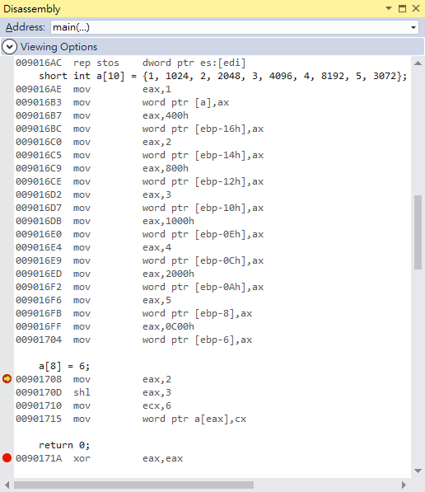
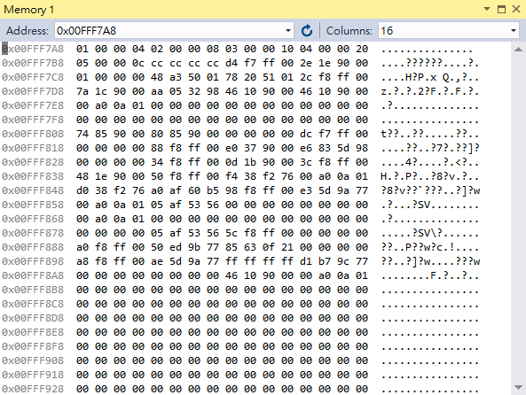
Dump memory

Slide 16
Array Initialization
If the initializer is shorter than the array, the remaining elements of the array are given the value 0:
int a[10] = {1, 2, 3, 4, 5, 6};
/* initial value of a is {1, 2, 3, 4, 5, 6, 0, 0, 0, 0} */
Using this feature, we can easily initialize an array to all zeros:
int a[10] = {0};
/* initial value of a is {0, 0, 0, 0, 0, 0, 0, 0, 0, 0} */
There’s a single 0 inside the braces because it’s legal for an initializer to be completely empty.
It’s also illegal for an initializer to be longer than the array it initializes.

Slide 17
Array Initialization
If an initializer is present, the length of the array may be omitted:
int a[] = {1, 2, 3, 4, 5, 6, 7, 8, 9, 10};
The compiler uses the length of the initializer to determine how long the array is.

Slide 18
Designated Initializers (C99)
It’s often the case that relatively few elements of an array need to be initialized explicitly; the other elements can be given default values.
An example:
int a[15]=
{0, 0, 29,0, 0, 0, 0, 0, 0, 7, 0, 0, 0, 0, 48};
For a large array, writing an initializer in this fashion is tedious and error-prone.

Slide 19
Designated Initializers (C99)
C99’s designated initializers can be used to solve this problem.
Here’s how we could redo the previous example using a designated initializer:
int a[15] = {[2] = 29, [9] = 7, [14] = 48};
// int a[15] =
// {0, 0, 29, 0, 0, 0, 0, 0, 0, 7, 0, 0, 0, 0, 48};
Each number in brackets is said to be a designator.

Slide 20
Designated Initializers (C99)
Designated initializers are shorter and easier to read (at least for some arrays).
Also, the order in which the elements are listed no longer matters.
Another way to write the previous example:
int a[15] = {[14] = 48, [9] = 7, [2] = 29};

Slide 21
Designated Initializers (C99)
Designators must be integer constant expressions.
If the array being initialized has length n, each designator must be between 0 and n – 1.
If the length of the array is omitted, a designator can be any nonnegative integer.
The compiler will deduce the length of the array from the largest designator.
The following array will have 24 elements:
int b[]={[5]= 10,[23]= 13, [11]= 36,[15]= 29};

Slide 22
Designated Initializers (C99)
An initializer may use both the (element-by-element) technique and the newer (designated) technique:
int c[10] = {5, 1, 9, [4] = 3, 7, 2, [8] = 6};

Slide 23
Program: Checking a Number for Repeated Digits
The repdigit.c program checks whether any of the digits in a number appear more than once.
After the user enters a number, the program prints either Repeated digit or No repeated digit:
Enter a number: 28212
Repeated digit
The number 28212 has a repeated digit (2); a number like 9357 doesn’t.

Slide 24
Program: Checking a Number for Repeated Digits
The program uses an array of 10 Boolean values to keep track of which digits appear in a number.
Initially, every element of the digit_seen array is false.
When given a number n, the program examines n’s digits one at a time, storing the current digit in a variable named digit.
If digit_seen[digit] is true, then digit appears at least twice in n.
If digit_seen[digit] is false, then digit has not been seen before, so the program sets digit_seen[digit] to true and keeps going.

Slide 25
#include <stdbool.h> /* C99 only */
#include <stdio.h>
int main(void)
{
bool digitSeen[10] = {false};
int digit;
long n;
printf("Enter a number: ");
scanf("%ld", &n);
while (n > 0)
{
digit = n % 10;
if (digitSeen[digit]) break;
digitSeen[digit] = true;
n /= 10;
}
if (n > 0) printf("Repeated digit\n");
else printf("No repeated digit\n");
return 0;
}
repdigit.c

Slide 26
Using the sizeof Operator with Arrays
The sizeof operator can determine the size of an array (in bytes).
If a is an array of 10 integers, then sizeof(a) is typically 40 (assuming that each integer requires four bytes).
We can also use sizeof to measure the size of an array element, such as a[0].
Dividing the array size by the element size gives the length of the array:
sizeof(a) / sizeof(a[0])

Slide 27
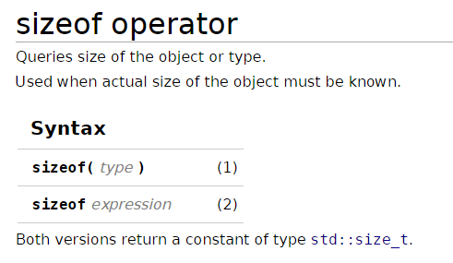
std::size_t is the unsigned integer type of the result of the sizeof operator

Slide 28
Using the sizeof Operator with Arrays
Some programmers use this expression when the length of the array is needed.
A loop that clears the array a:
for (i = 0; i < sizeof(a) / sizeof(a[0]); i++)
a[i] = 0;
Pros:
loop doesn’t have to be modified if the array length should change at a later date.

Slide 29
Using the sizeof Operator with Arrays
Some compilers produce a warning message for the expression i < sizeof(a) / sizeof(a[0]).
The variable i probably has type int (a signed type), whereas sizeof produces a value of type size_t (an unsigned type).
Comparing a signed integer with an unsigned integer can be dangerous, but in this case it’s safe.

Slide 30
Using the sizeof Operator with Arrays
To avoid a warning, we can add a cast that converts sizeof(a) / sizeof(a[0]) to a signed integer:
for (i= 0; i <(int)(sizeof(a)/sizeof(a[0])); i++)
a[i] = 0;
Defining a macro for the size calculation is often helpful:
#define SIZE ((int)(sizeof(a) / sizeof(a[0])))
for (i = 0; i < SIZE; i++) a[i] = 0;

Slide 31
Program: Computing Interest
The interest.c program prints a table showing the value of $100 invested at different rates of interest over a period of years.
The user will enter an interest rate and the number of years the money will be invested.
The table will show the value of the money at one-year intervals—at that interest rate and the next four higher rates—assuming that interest is compounded once a year.

Slide 32
Program: Computing Interest
Here’s what a session with the program will look like:
Enter interest rate: 6
Enter number of years: 5
Years 6% 7% 8% 9% 10%
1 106.00 107.00 108.00 109.00 110.00
2 112.36 114.49 116.64 118.81 121.00
3 119.10 122.50 125.97 129.50 133.10
4 126.25 131.08 136.05 141.16 146.41
5 133.82 140.26 146.93 153.86 161.05

Slide 33
Program: Computing Interest
The numbers in the second row depend on the numbers in the first row, so it makes sense to store the first row in an array.
The values in the array are then used to compute the second row.
This process can be repeated for the third and later rows.
The program uses nested for statements.
The outer loop counts from 1 to the number of years requested by the user.
The inner loop increments the interest rate from its lowest value to its highest value.

Slide 34
interest.c
#include <stdio.h>
#define NUM_RATES ((int)(sizeof(value)/ sizeof(value[0])))
#define INITIAL_BALANCE 100.00
int main(void)
{
int i, lowRate, numOfYears, year;
double value[5];
printf("Enter interest rate: ");
scanf("%d", &lowRate);
printf("Enter number of years: ");
scanf("%d", &numOfYears);

Slide 35
printf("\nYears");
for (i = 0; i < NUM_RATES; i++)
{
printf("%6d%%", lowRate + i);
value[i] = INITIAL_BALANCE;
}
printf("\n");
for (year = 1; year <= numOfYears; year++)
{
printf("%3d ", year);
for (i = 0; i < NUM_RATES; i++)
{
value[i]+= (lowRate+ i)/100.0*value[i];
printf("%7.2f", value[i]);
}
printf("\n");
}
return 0;
}

Slide 36
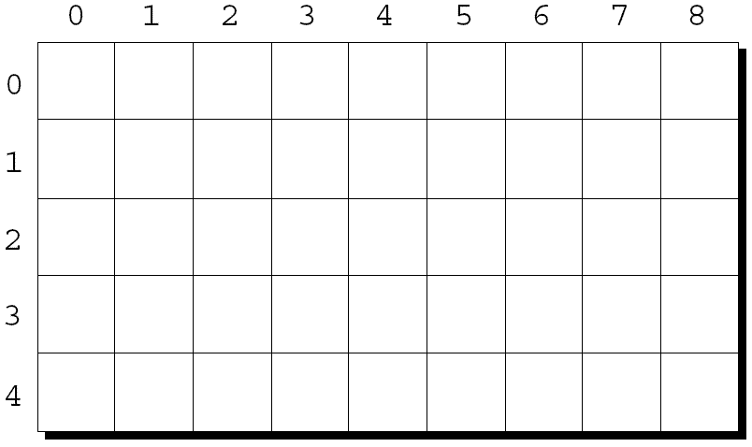
Multidimensional Arrays
An array may have any number of dimensions.
The following declaration creates a two-dimensional array (a matrix, in mathematical terminology):
int m[5][9];
m has 5 rows and 9 columns. Both rows and columns are indexed from 0:

Slide 37
Multidimensional Arrays
To access the element of m in row i, column j, we must write m[i][j].
The expression m[i] designates row i of m, and m[i][j] then selects element j in this row.
Resist the temptation to write m[i,j] instead of m[i][j].
C treats the comma as an operator in this context, so m[i,j] is the same as m[j].

Slide 38
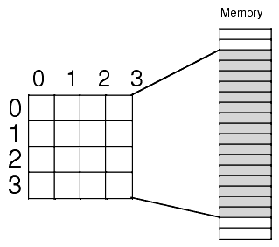
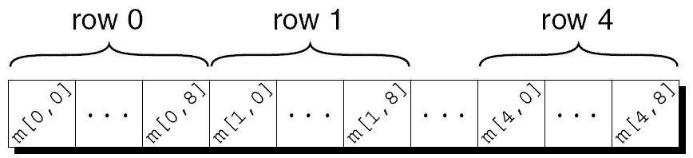
Multidimensional Arrays
Although we visualize two-dimensional arrays as tables, that’s not the way they’re actually stored in computer memory.
C stores arrays in row-major order, with row 0 first, then row 1, and so forth.
How the m array is stored:

Slide 39
Multidimensional Arrays
Nested for loops are ideal for processing multidimensional arrays.
Consider the problem of initializing an array for use as an identity matrix. A pair of nested for loops is perfect:
#define N 10
double ident[N][N];
int row, col;
for (row = 0; row < N; row++)
for (col = 0; col < N; col++)
if (row == col)
ident[row][col] = 1.0;
else
ident[row][col] = 0.0;

Slide 40
Initializing a Multidimensional Array
We can create an initializer for a two-dimensional array by nesting one-dimensional initializers:
int m[5][9] ={{1, 1, 1, 1, 1, 0, 1, 1, 1},
{0, 1, 0, 1, 0, 1, 0, 1, 0},
{0, 1, 0, 1, 1, 0, 0, 1, 0},
{1, 1, 0, 1, 0, 0, 0, 1, 0},
{1, 1, 0, 1, 0, 0, 1, 1, 1}};
Initializers for higher-dimensional arrays are constructed in a similar fashion.
C provides a variety of ways to abbreviate initializers for multidimensional arrays

Slide 41
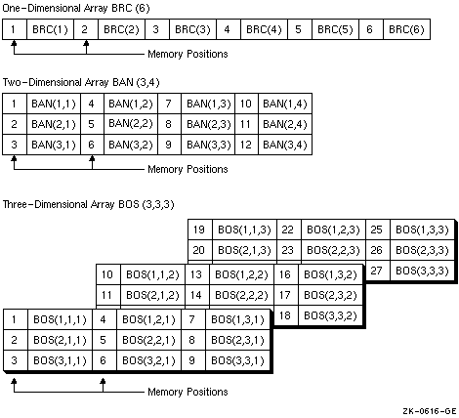
(column major)

Slide 42
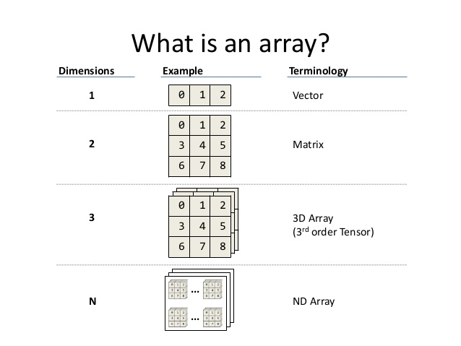

Slide 43
Initializing a Multidimensional Array
If an initializer isn’t large enough to fill a multidimensional array, the remaining elements are given the value 0.
The following initializer fills only the first three rows of m; the last two rows will contain zeros:
int m[5][9] = {{1, 1, 1, 1, 1, 0, 1, 1, 1},
{0, 1, 0, 1, 0, 1, 0, 1, 0},
{0, 1, 0, 1, 1, 0, 0, 1, 0}};

Slide 44
Initializing a Multidimensional Array
If an inner list isn’t long enough to fill a row, the remaining elements in the row are initialized to 0:
int m[5][9] = {{1, 1, 1, 1, 1, 0, 1, 1, 1},
{0, 1, 0, 1, 0, 1, 0, 1},
{0, 1, 0, 1, 1, 0, 0, 1},
{1, 1, 0, 1, 0, 0, 0, 1},
{1, 1, 0, 1, 0, 0, 1, 1, 1}};

Slide 45
Initializing a Multidimensional Array
We can even omit the inner braces:
int m[5][9] = {1, 1, 1, 1, 1, 0, 1, 1, 1,
0, 1, 0, 1, 0, 1, 0, 1, 0,
0, 1, 0, 1, 1, 0, 0, 1, 0,
1, 1, 0, 1, 0, 0, 0, 1, 0,
1, 1, 0, 1, 0, 0, 1, 1, 1};
Once the compiler has seen enough values to fill one row, it begins filling the next.
Omitting the inner braces can be risky, since an extra element (or even worse, a missing element) will affect the rest of the initializer.

Slide 46
Initializing a Multidimensional Array
C99’s designated initializers work with multidimensional arrays.
How to create 2 × 2 identity matrix:
double ident[2][2]={[0][0]=1.0, [1][1]= 1.0};
As usual, all elements for which no value is specified will default to zero.

Slide 47
Constant Arrays
An array can be made “constant” by starting its declaration with the word const:
const char hexChars[] =
{'0', '1', '2', '3', '4', '5', '6', '7', '8', '9','A', 'B', 'C', 'D', 'E', 'F'};
An array that’s been declared const should not be modified by the program.

Slide 48
Constant Arrays
Advantages of declaring an array to be const:
Documents that the program won’t change the array.
Helps the compiler catch errors.
const isn’t limited to arrays, but it’s particularly useful in array declarations.

Slide 49

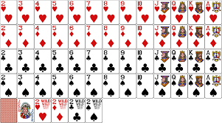
Program: Dealing a Hand of Cards
The deal.c program illustrates both two-dimensional arrays and constant arrays.
The program deals a random hand from a standard deck of playing cards.
Each card in a standard deck has
a suit (clubs , diamonds, hearts, or spades) and
a rank (two, three, four, five, six, seven, eight, nine, ten, jack, queen, king, or ace).

Slide 50
Program: Dealing a Hand of Cards
The user will specify how many cards should be in the hand:
Enter number of cards in hand: 5
Your hand: 7c 2s 5d as 2h
Problems to be solved:
How do we pick cards randomly from the deck?
How do we avoid picking the same card twice?

Slide 51
Program: Dealing a Hand of Cards
To pick cards randomly, we’ll use several C library functions:
time (from <time.h>) – returns the current time, encoded in a single number.
srand (from <stdlib.h>) – initializes C’s random number generator.
rand (from <stdlib.h>) – produces an apparently random number each time it’s called.
By using the % operator, we can scale the return value from rand so that it falls between 0 and 3 (for suits) or between 0 and 12 (for ranks).

Slide 52
Program: Dealing a Hand of Cards
Data structure:
An array inHand[suits][ranks]= false;
to keep track of which cards have already been chosen.
inHand[4][13]= {false};
Check duplication for each chosen card
If inHhand[#suit][#rank] is
true, we’ll have to pick another card.
false, we’ll store true in that element to remind us later that this card has already been picked.

Slide 53
Program: Dealing a Hand of Cards
Once we’ve verified that a card is “new,” we’ll need to translate its numerical rank and suit into characters and then display the card.
To translate the rank and suit to character form, we’ll set up two arrays of characters—one for the rank and one for the suit—and then use the numbers to subscript the arrays.
These arrays won’t change during program execution, so they are declared to be const.

Slide 54
#include <stdbool.h> /* C99 only */
#include <stdio.h>
#include <stdlib.h>
#include <time.h>
#define NUM_SUITS 4
#define NUM_RANKS 13
int main(void)
{
bool inHand[NUM_SUITS][NUM_RANKS] = {false};
int numOfCards, rank, suit;
const char rankCode[] = {'2','3','4','5','6','7','8',
'9','t','j','q','k','a'};
const char suitCode[] = {'c','d','h','s'};
srand((unsigned) time(NULL));
deal.c

Slide 55
printf("Enter number of cards in hand: ");
scanf("%d", &numOfCards);
printf("Your hand:");
while (numOfCards > 0) {
suit = rand() % NUM_SUITS;/* picks a random suit */
rank = rand() % NUM_RANKS;/* picks a random rank */
if (! inHand[suit][rank]) {
inHand[suit][rank] = true;
numOfCards--;
printf(" %c%c", rankCode[rank], suitCode[suit]);
}
}
printf("\n");
return 0;
}

Slide 56
Example Programs- Array

Slide 57
#include <stdio.h>
int main ()
{
int n[ 10 ]; /* n is an array of 10 integers */
int i,j;
// initialize elements of array
for ( i = 0; i < 10; i++ )
{
n[ i ] = i + 100; /* set element at location i to i + 100 */
}
/* output each array element's value */
for (j = 0; j < 10; j++ )
{
printf("Element[%d] = %d\n", j, n[j] );
}
return 0;
}
Output= ?

Slide 58
#include <stdio.h>
int main ()
{
int n[ 10 ]; /* n is an array of 10 integers */
int i,j;
/* initialize elements of array n to 0 */
for ( i = 0; i < 10; i++ )
{
n[ i ] = i + 100; /* set element at location i to i + 100 */
}
/* output each array element's value */
for (j = 0; j < 10; j++ )
{
printf("Element[%d] = %d\n", j, n[j] );
}
return 0;
}
Element[0] = 100 Element[1] = 101 Element[2] = 102 Element[3] = 103 Element[4] = 104 Element[5] = 105 Element[6] = 106 Element[7] = 107 Element[8] = 108 Element[9] = 109

Slide 59
Example: Find 2 Elements in the Array such that Difference between them is Largest

Slide 60
#include <stdio.h>
int maxDifference(int array[], int arrSize) {
int maxDiff = array[1] - array[0];
int i, j;
for (i = 0; i < arrSize; i++) {
for (j = i + 1; j < arrSize; j++)
if (array[j] - array[i] > maxDiff)
maxDiff = array[j] - array[i];
}
return maxDiff;
}
int main() {
int array[] = { 10, 15, 90, 200, 110 };
printf("Maximum difference is %d", maxDifference(array, 5));
return 0;
}
Answer= ?

Slide 61
Variable-Length Arrays (C99)
In C89, the length of an array variable must be specified by a constant expression.
In C99, however, it’s sometimes possible to use an expression that’s not constant.
The reverse2.c program—a modification of reverse.c—illustrates this ability.

Slide 62
/* Reverses a series of numbers using a variable-length
array - C99 only */
#include <stdio.h>
int main(void)
{
int i, n;
printf("How many numbers do you want to reverse? ");
scanf("%d", &n);
int a[n]; /* C99 only- length of array depends on n*/
printf("Enter %d numbers: ", n);
for (i = 0; i < n; i++)
scanf("%d", &a[i]);
printf("In reverse order:");
for (i = n - 1; i >= 0; i--) printf(" %d", a[i]);
printf("\n");
return 0;
}
reverse2.c

Slide 63
Variable-Length Arrays (C99)
The array a in the reverse2.c program is an example of a variable-length array (or VLA).
The length of a VLA is computed when the program is executed.
The chief advantage of a VLA is that a program can calculate exactly how many elements are needed.
If the programmer makes the choice, it’s likely that the array will be too long (wasting memory) or too short (causing the program to fail).

Slide 64
Variable-Length Arrays (C99)
The length of a VLA doesn’t have to be specified by a single variable. Arbitrary expressions are legal:
int a[3*i+5];
int b[j+k];
Like other arrays, VLAs can be multidimensional:
int c[m][n];
Restrictions on VLAs:
Can’t have static storage duration (discussed in Chapter 18).
Can’t have an initializer.

